Slide 1
C++ Standard Library ‘Little Things’
Billy O’Neal, Visual C++ Libraries
bion@Microsoft.com
@MalwareMinigun
Notes:
35 minutes, code in 28 font

Slide 2

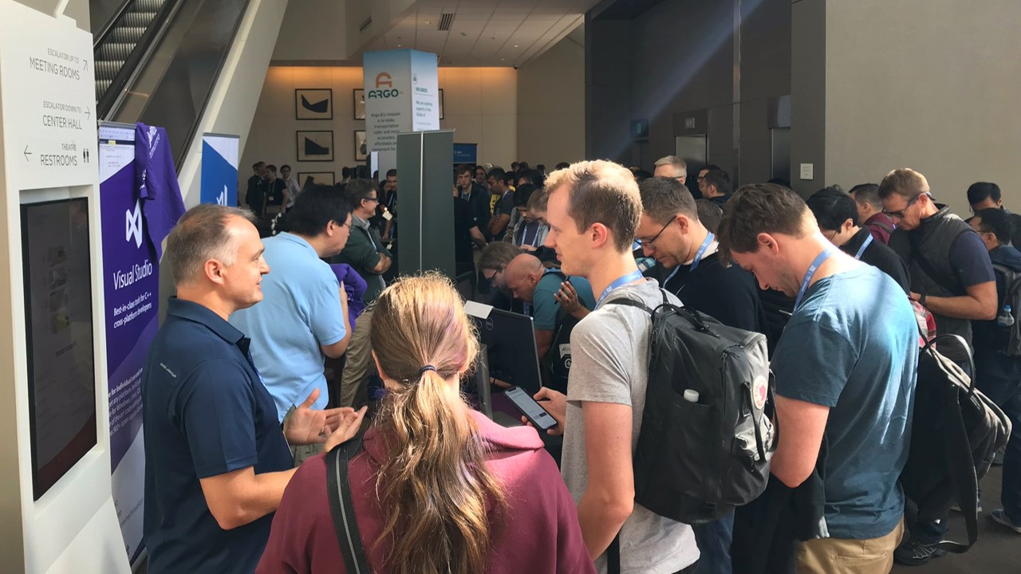


Come say hi 🗣 Visit our Microsoft booth
Mon – Thu
Outside Aurora D
Notes:
Sy: The booth is outside of Aurora D

Slide 3


👓 Help us learn 📝 Take our survey https://aka.ms/cppcon 🎁 And have a chance to win an Xbox One S
Fri 9/20 16:15 – 18:00
De-fragmenting C++: Making Exceptions and RTTI More Affordable and Usable (“Simplifying C++” #6 of N)
Herb Sutter @ Aurora A

Slide 4
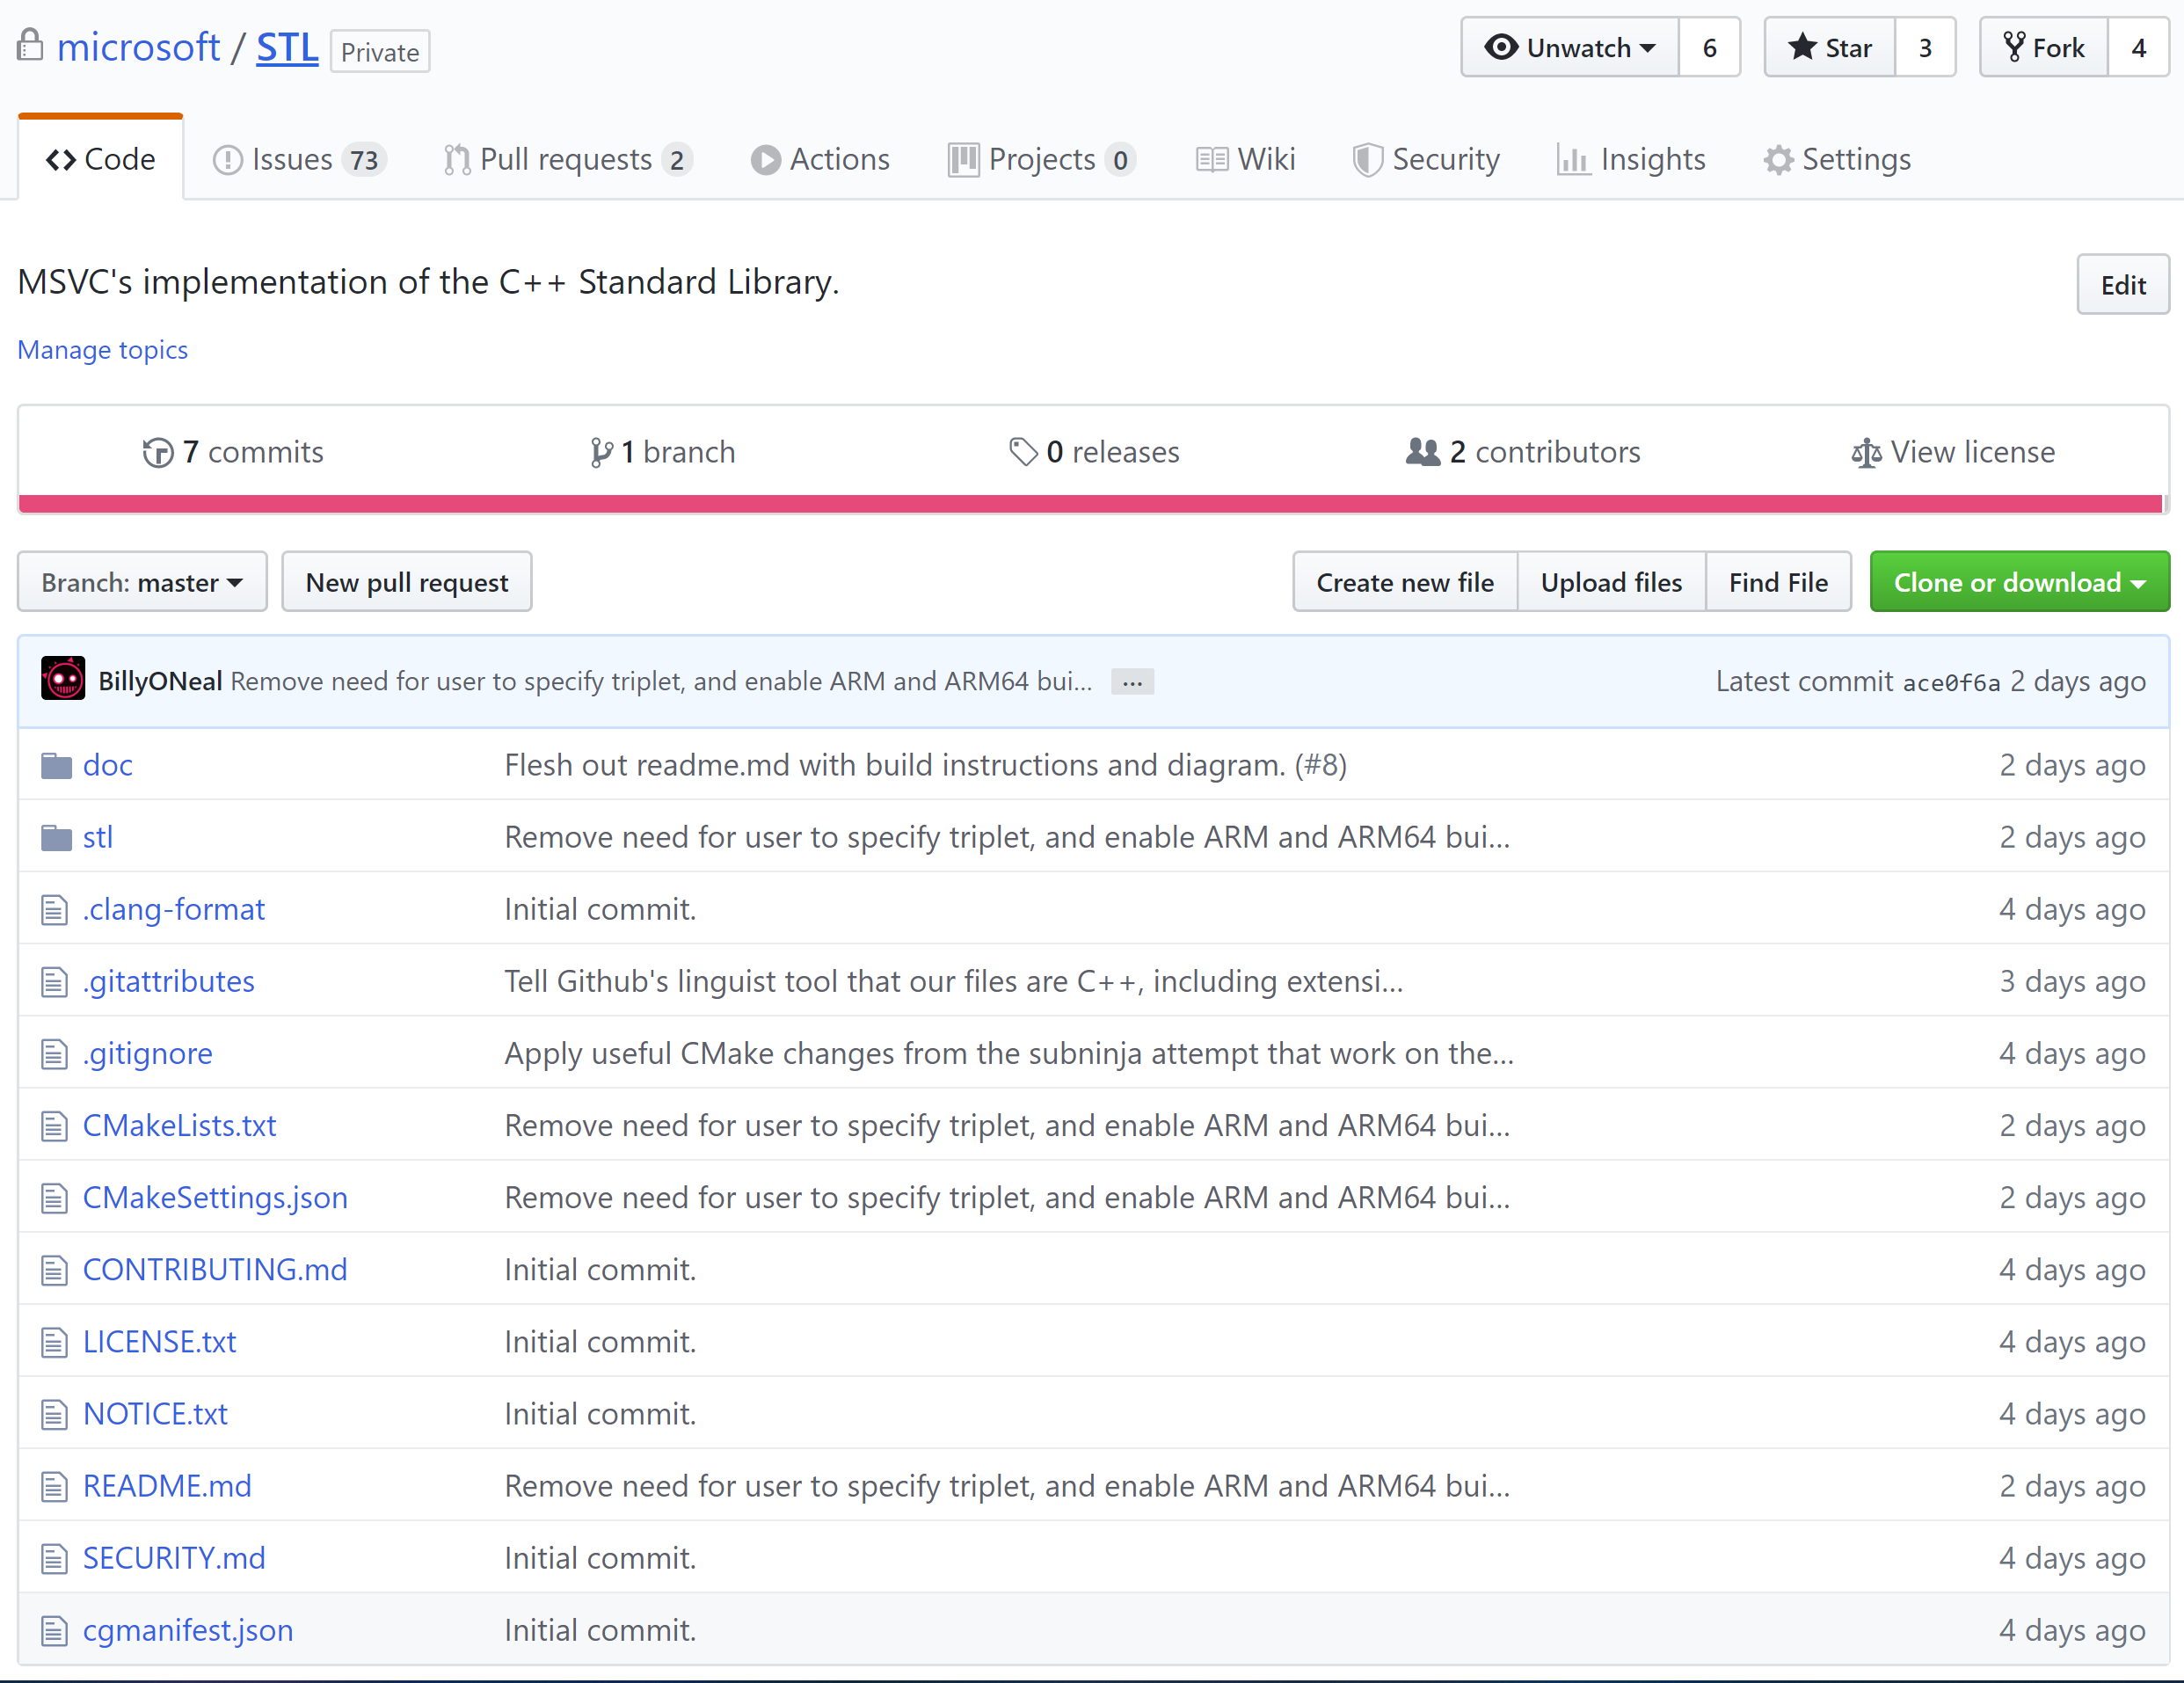

Slide 5

This talk in a nutshell
Go to the compiler feature support page on cppreference:
https://en.cppreference.com/w/cpp/compiler_support
and look at *all* the things voted in, not just headline ones about which people usually write talks.
Walnut.png from: https://en.wikipedia.org/wiki/Template:Nutshell

Slide 6
In this talk
Feature test macros (C++20)
starts_with + ends_with (C++20)
std::clamp (C++17)
std::exchange (C++14)
Variadic lock_guard (C++17)
Parallel Algorithms (C++17)
Associative contains (C++20)
Splicing Maps and Sets (C++17)
Unordered transparency (C++20)

Slide 7
Feature Test Macros (C++20)
Test if the compiler or standard library implements a given feature for the current build mode
Core features: http://eel.is/c++draft/cpp.predefined
Library features: http://eel.is/c++draft/support.limits.general
Examples of proper use from http://eel.is/c++draft/cpp.cond

Slide 8
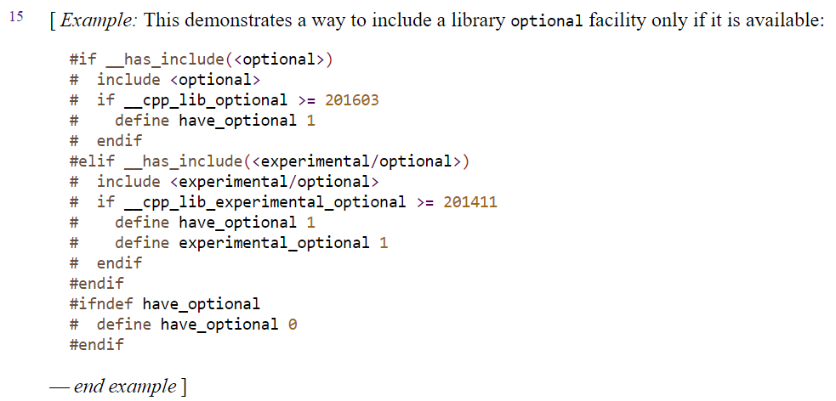
Feature Test Macros (C++20)

Slide 9
starts_with and ends_with (C++20)
Exactly what it says:
using namespace std::string_view_literals;
constexpr auto s = "hello world"sv;
static_assert(s.starts_with("hello"sv));
static_assert(!s.ends_with("hello"sv));
static_assert(!s.starts_with(" world"sv));
static_assert(s.ends_with(" world"sv));

Slide 10
std::clamp (C++17)
#include <algorithm>
constexpr int a = std::clamp(1234, 10, 20);
constexpr int b = std::clamp(11, 10, 20);
constexpr int c = std::clamp(0, 10, 20);
static_assert(a == 20);
static_assert(b == 11);
static_assert(c == 10);

Slide 11
std::exchange (C++14)
Equivalent to moving out a T, and move assigning over it
template <class T, class Other = T>
T exchange(T& val, Other&& new_val) {
T old_val = static_cast<T&&>(val);
val = static_cast<Other&&>(new_val);
return old_val;
}

Slide 12
std::exchange (C++14)
== std::move
template <class T, class Other = T>
T exchange(T& val, Other&& new_val) {
T old_val = static_cast<T&&>(val);
val = static_cast<Other&&>(new_val);
return old_val;
}
== std::forward
== std::move!

Slide 13
std::exchange (C++14)
std::string Detach() {
std::string old = std::move(member);
member = {};
return old;
}
std::string Detach() {
return std::exchange(member, {});
}

Slide 14
Variadic lock_guard: scoped_lock (C++17)
Takes multiple locks using a deadlock avoidance algorithm
Oblivious to mutex type, scheduler, etc.
template<class... MutexTypes>
class scoped_lock;
Notes:
http://howardhinnant.github.io/dining_philosophers.html#Explanation

Slide 15
scoped_lock (C++17)
struct DataValue {
mutable std::shared_mutex m;
int theValue;
};
void modify_both(DataValue& a, DataValue& b) {
std::scoped_lock lock(a.m, b.m); // takes both
// mutexes without deadlock
std::swap(a.theValue, b.theValue);
// both mutexes are unlocked upon exiting the scope
}

Slide 16
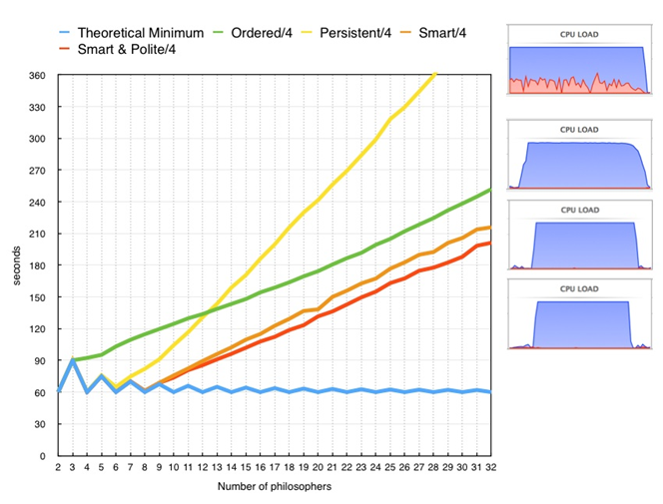
scoped_lock (C++17)
More efficient than defining a lock ordering, see http://howardhinnant.github.io/dining_philosophers.html#Explanation

Slide 17
Parallel Algorithms (C++17)
std::sort(a, b, pred) => std::sort(std::execution::par, a, b, pred)
See blog post for more nitty gritty:
https://devblogs.microsoft.com/cppblog/using-c17-parallel-algorithms-for-better-performance/
See my talk last year for how this works inside MSVC:
https://youtu.be/nOpwhTbulmk

Slide 18
Parallel Algorithms (C++17)
state.PauseTiming();
vector<T> data(r0);
fill_with_random(data);
state.ResumeTiming();
sort(execution::par,
data.begin(), data.end(), less<>{});

Slide 19
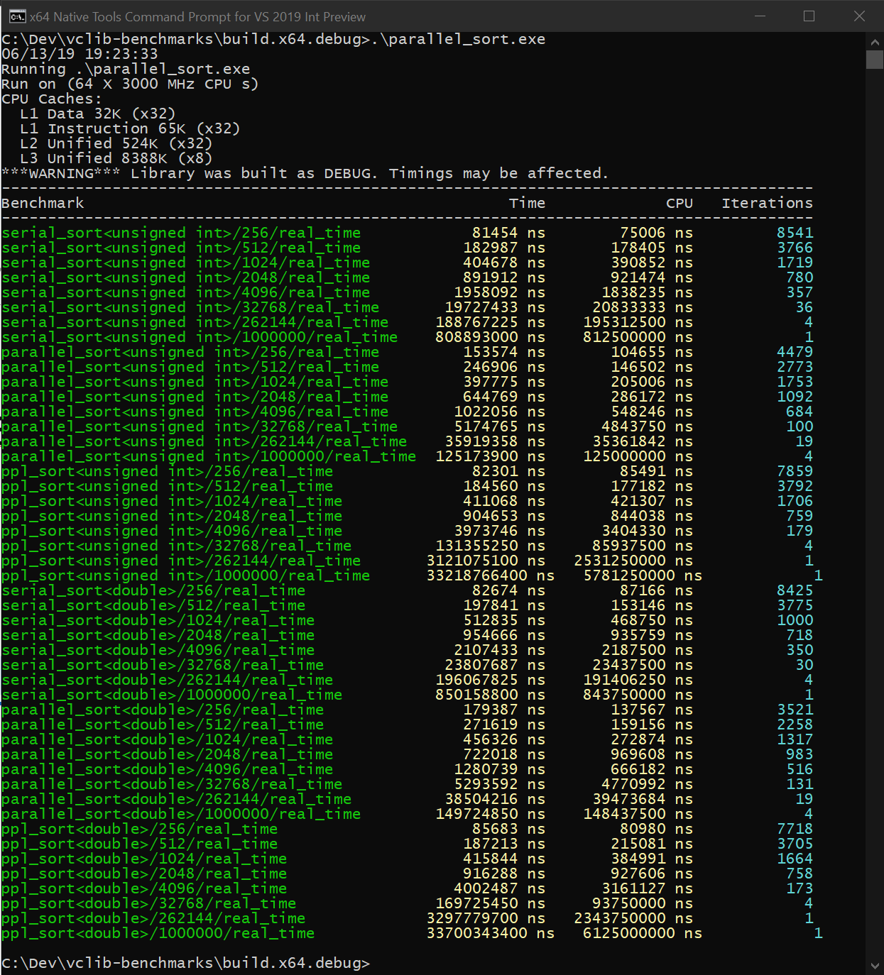
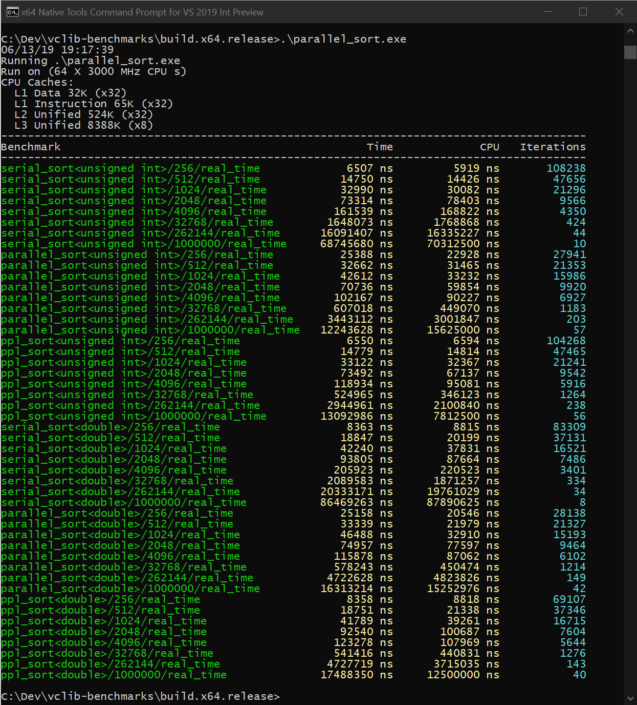
Parallel Algorithms (C++17)
Example output, see parallel_sort.cpp on GitHub

Slide 20
Parallel Algorithms (C++17)
Debug, 32 cores
element count | 256 | 512 | 1024 | 2048 | 4096 | 262144 | 1000000
serial, unsigned int (μs) | 81 | 183 | 405 | 892 | 1958 | 188767 | 808893
parallel, unsigned int (μs) | 154 | 247 | 398 | 645 | 1022 | 35919 | 125174
Relative Time | 1.90 | 1.35 | 0.98 | 0.72 | 0.52 | 0.19 | 0.15
Win, Times | 0.53 | 0.74 | 1.02 | 1.38 | 1.92 | 5.26 | 6.46
ppl, unsigned int (μs) | 82 | 184 | 411 | 905 | 3874 | 3121075 | 33218766
Relative Time | 1.01 | 1.01 | 1.01 | 1.01 | 1.98 | 16.53 | 41.07
Win, Times | 0.99 | 0.99 | 0.99 | 0.99 | 0.51 | 0.06 | 0.02

Slide 21
Parallel Algorithms (C++17)
Release, 32 cores
element count | 256 | 512 | 1024 | 2048 | 4096 | 262144 | 1000000
serial, unsigned int (μs) | 7 | 15 | 33 | 73 | 161 | 16091 | 68746
parallel, unsigned int (μs) | 25 | 33 | 46 | 71 | 102 | 3443 | 12244
Relative Time | 3.57 | 2.20 | 1.39 | 0.97 | 0.63 | 0.21 | 0.18
Win, Times | 0.28 | 0.45 | 0.72 | 1.03 | 1.58 | 4.67 | 5.61
ppl, unsigned int (μs) | 7 | 15 | 33 | 73 | 119 | 2945 | 13093
 | 1.00 | 1.00 | 1.00 | 1.00 | 0.74 | 0.18 | 0.19
 | 1.00 | 1.00 | 1.00 | 1.00 | 1.35 | 5.46 | 5.25

Slide 22
Parallel Algorithms (C++17)
Release (4 Core Laptop)
element count | 256 | 512 | 1024 | 2048 | 4096 | 262144 | 1000000
serial, unsigned int (μs) | 8 | 17 | 39 | 87 | 190 | 19405 | 80760
parallel, unsigned int (μs) | 14 | 23 | 36 | 55 | 92 | 4798 | 19591
Relative Time | 1.75 | 1.35 | 0.92 | 0.63 | 0.48 | 0.25 | 0.24
Win, Times | 0.57 | 0.74 | 1.08 | 1.58 | 2.07 | 4.04 | 4.12
ppl, unsigned int (μs) | 8 | 17 | 43 | 85 | 116 | 4814 | 18836
 | 1.00 | 1.00 | 1.10 | 0.98 | 0.61 | 0.25 | 0.23
 | 1.00 | 1.00 | 0.91 | 1.02 | 1.64 | 4.03 | 4.29

Slide 23
Contains (C++20)
New member of maps and sets that does just what it says – bool to ask if an element is in the container
Alternative to find() != end() or count() != 0

Slide 24
Contains (C++20)
printf("find != end 24: %s\n",
s.find(24) != s.end() ? "true" : "false");
printf("find != end 67: %s\n",
s.find(67) != s.end() ? "true" : "false");
printf("count 24: %s\n", s.count(24) != 0 ? "true" : "false");
printf("count 67: %s\n", s.count(67) != 0 ? "true" : "false");
printf("contains 24: %s\n", s.contains(24) ? "true" : "false");
printf("contains 67: %s\n", s.contains(67) ? "true" : "false");

Slide 25
Splicing Maps and Sets (C++17)
Extract elements from maps or sets, and mutate them or reinsert them later
Combine maps and sets into each other with the merge member
No allocations

Slide 26
Splicing Maps and Sets (C++17)
Node-based containers
Not node-based
list (C++98/03)
forward_list (C++11)
(multi)set
(multi)map
unordered_(multi)set
unordered_(multi)map
array
deque*
vector
vector<bool>
string
bitset
valarray

Slide 27
Splicing Maps and Sets (C++17)
end

Slide 28
Splicing Maps and Sets (C++17)
head

Slide 29
Splicing Maps and Sets (C++17)
end

Slide 30
Splicing Maps and Sets (C++17)
buckets

Slide 31
Splicing Maps and Sets (C++17)
buckets

Slide 32
Splicing Maps and Sets (C++17)
buckets
end

Slide 33
Splicing Maps and Sets (C++17)
std::vector
std::list
buckets
end

Slide 34
Splicing Maps and Sets (C++17)
container::node_type
pointer to node
allocator

Slide 35
Splicing Maps and Sets (C++17)
using UnwindMapData =
UtcPool::map<T_ALLOC, EHSTATE, UWentry>;
for (auto &UWEntry : funcInfo.UnwindMap)
{
// Change entry to be keyed off new state
const_cast<T&>(UWEntry.first) = newState;
}

Slide 36
Splicing Maps and Sets (C++17)
using UnwindMapData =
UtcPool::map<T_ALLOC, EHSTATE, UWentry>;
for (auto &UWEntry : funcInfo.UnwindMap)
{
// Change entry to be keyed off new state
auto movedEntry =
funcInfo.UnwindMap.extract(UWEntry.first);
movedEntry.key() = newState;
funcInfo.UnwindMap.insert(move(movedEntry));
}

Slide 37
Splicing Maps and Sets (C++17)
std::set set1 = {1, 2, 4, 1000, 1234, -67, 1729};
std::set set2 = {-1, 2, 4, -1000, 1234, 7, -1729};
print_ints("set1", set1);
print_ints("set2", set2);
set1.merge(set2);
// set1 == {-1729, -1000, -67, -1, 1, 2, 4, 7, 1000,
// 1234, 1729}
// set2 == {2, 3, 1234}
print_ints("set1, after merge", set1);
print_ints("set2, after merge", set2);

Slide 38
Unordered Transparency (C++20)
void example(std::set<std::string>& s) {
s.find("hello world"); // implicitly allocates memory :(
s.find("hello world"sv); // doesn't compile X(
s.find(std::string("hello world"sv)); // allocates memory :(
}
void example(std::set<std::string, std::less<>>& s) {
s.find("hello world"); // doesn't allocate memory but strlen :/
s.find("hello world"sv); // doesn't allocate memory :D
}

Slide 39
Unordered Transparency (C++20)
Like C++14 transparent ordered associative containers extended to unordered containers
Then: std::map<std::string, int, std::less<>>
Now: std::unordered_map<std::string, int, ASpecialHash>

Slide 40
Unordered Transparency (C++20)
struct hasher {
// equal_to has is_transparent
using transparent_key_equal = std::equal_to<>;
std::size_t operator()(std::string_view sv) {
return std::hash<std::string_view>{}(sv);
}
};
void example(std::unordered_set<std::string, hasher>& s) {
s.find("hello world"); // doesn't allocate memory but strlen :/
s.find("hello world"sv); // doesn't allocate memory :D
}

Slide 41
(Insert other MS cppcon talks on this slide)

Slide 42

Other talks from Microsoft
Monday, September 16th
14:00 – 15:00: Hello World From Scratch by Sy Brand and Peter Bindels
15:15 – 16:15: Programming with C++ Modules: Guide for the Working Programmer by Gabriel Dos Reis
16:45 – 17:45: Latest & Greatest in Visual Studio 2019 for C++ Developers by Sy Brand and Marian Luparu
Tuesday, September 17th
15:15 – 15:45: What’s New in Visual Studio Code for C++ Development – Remote Development, IntelliSense, Build/Debug, vcpkg, and More! by Tara Raj
15:50 – 16:10: (Ab)using Compiler Tools Summit by Réka Kovács
15:50 – 16:10: C++ Standard Library “Little Things” by Billy O’Neal
15:50 – 16:10: Upgrade from “permissive C++” to “modern C++” with Visual Studio 2019 by Nick Uhlenhuth
Wednesday, September 18th
09:00 – 09:30: How to Herd 1,000 Libraries by Robert Schumacher
14:00 – 15:00 C++ Sanitizers and Fuzzing for the Windows Platform Using New Compilers, Visual Studio, and Azure by Jim Radigan
14:00 – 15:00 Lifetime analysis for everyone by Gábor Horváth and Matthias Gehre
16:45 – 17:45: Killing Uninitialized Memory: Prot by Joe Bialek and Shayne Hiet-Block
Thursday, September 19th
15:15 – 15:45: Don’t Package Your Libraries, Write Packagable Libraries! (Part 2) by Robert Schumacher
16:45 – 17:45: Floating-Point charconv: Making Your Code 10x Faster With C++17’s Final Boss by Stephan T. Lavavej
Friday, September 20th
16:15 – 18:00: De-fragmenting C++: Making Exceptions and RTTI More Affordable and Usable (“Simplifying C++” #6 of N) by Herb Sutter

Slide 43
Thanks all!
Talk materials at https://github.com/BillyONeal/14_cpp_features_in_40_minutes

Slide 44
Backup Slides

Slide 45
Increasing safety of unions: std::variant (C++17)
Tagged / discriminated union which keeps track of which union member is active.
Multiples of the same type are allowed: variant<int, int, int>.
Supports visitation scenarios, useful in cases like collision modeling.

Slide 46
Increasing safety of unions: std::variant (C++17)
struct JsonArray {};
struct JsonObject {};
struct JsonNumber {};
std::variant<JsonArray, JsonObject, JsonNumber>
parse_json(const char*);
// expected the user to say "42", but said "{42}":
auto v = parse_json("{42}");
v.index(); // gets the active variant member index
std::get<JsonNumber>(v); // throws bad_variant_access
std::get<JsonObject>(v); // returns reference to the JsonObject
std::get<0>(v); // also bad_variant_access
std::get<1>(v); // ok
// destructor of the active variant member called automatically

Slide 47
Increasing safety of unions: std::variant (C++17)
Conversions are handled for you
std::variant<std::string, double> g() {
return "hello world";
}

Slide 48
Increasing safety of unions: std::variant (C++17)
#include <stdio.h>
#include <string>
#include <variant>
struct Success {};
struct Failure {
std::string message;
};
std::variant<Success, Failure> do_thing() {
if (2 + 2 == 5) { // for large values of 2?
return Failure{"Math is broken"};
}
return Success{};
}

Slide 49
Increasing safety of unions: std::variant (C++17)
int main() {
auto result = do_thing();
switch(result.index()) {
case 0: // active member is Success
puts("Success");
break;
case 1:
puts("Failure:");
puts(std::get<Failure>(result).message.c_str());
// variant took care of destroying the string inside
break;
}
}

Slide 50
Behavior for each type: std::visit
struct Visitor {
void operator()(const Success&) const {
puts("Success");
}
void operator()(const Failure& f) const {
puts("Failure");
puts(f.message.c_str());
}
};
std::visit(Visitor{}, do_thing());

Slide 51
std::visit passing through return types
#include <Windows.h>
struct HResultVisitor {
HRESULT operator()([[maybe_unused]] const Success& s) const {
return S_OK;
}
HRESULT operator()([[maybe_unused]] const Failure& f) const {
return E_FAIL;
}
};
extern "C" HRESULT __stdcall some_c_api_wrapper() noexcept {
return std::visit(HResultVisitor{}, do_thing());
}

Slide 52
Multiple variants: collision modeling
#include <stdio.h>
#include <variant>
struct LeftClick {};
struct RightClick {};
using ClickType = std::variant<LeftClick, RightClick>;
struct Button {};
struct Widget {};
struct TextBox {};
using TargetType = std::variant<Button, Widget, TextBox>;
void HandleCollision(const ClickType& click, const TargetType& target);

Slide 53
void HandleCollision(const ClickType& click,
const TargetType& target) {
struct Visitor {
void operator()(LeftClick, Button) const {
puts("Button was left clicked");
}
void operator()(LeftClick, Widget) const {
puts("Widget was left clicked");
}
void operator()(LeftClick, TextBox) const {
puts("TextBox was left clicked");
}
void operator()(RightClick, Button) const {
puts("Button was right clicked");
}
void operator()(RightClick, Widget) const {
puts("Widget was right clicked");
}
void operator()(RightClick, TextBox) const {
puts("TextBox was right clicked");
}
};
std::visit(Visitor{}, click, target);
}

